Slide 1

Course Name: Hardware Security
Faculty Name: Prof Debdeep Mukhopadhyay
Department : Computer Science and Engineering
Topic
Lecture 04: Finite Field Architectures-1

Slide 2

Concepts Covered:
Finite Fields or Galois Fields
Characteristic-2 Finite Field Operations
Karatsuba Multipliers
Modulo Operation in GF(2)

Slide 3
Finite Fields
A finite field is a field with a finite number of elements.
The number of elements in the set is called the order of the field.
A field with order m exists iff m is a prime power, i.e m=p^{n} for some integer n and with p a prime integer.
p is called the characteristic of the finite field.
https://www.youtube.com/watch?v=SCvtxjpVQms&index=3&list=PL71FE85723FD414D7

Slide 4
Galois Fields
GF(p): The elements of the fields can be represented by 0, 1, …, p-1
However if p is not prime, then multiplications are not defined.
However for finite fields GF(p^{n}), with n>1, slightly complex representations are used.
Elements are represented as polynomials over GF(p).

Slide 5
Binary Finite Fields
A finite field defines a finite set S and two commutative operations ( ∙ , + ) in which
Two elements can be added, subtracted, multiplied
Any element can be divided by a non-zero element
Multiplication distributes over addition
Binary Finite Fields: The set S consists polynomials with coefficients in {0,1}
Also known as Galois field
Represented as GF(2^{m}), where 2^{m} is the number of elements in S
AES is constructed using binary finite fields

Slide 6
Polynomials over a field

Slide 7
Operations on Polynomials
Addition:

Slide 8
Example

Slide 9
Multiplication
Associative
Commutative
Distributive wrt. addition of polynomials.

Slide 10
Irreducible Polynomial
A polynomial d(x) is irreducible over the field GF(p) iff there exist no two polynomials a(x) and b(x) with coefficients in GF(p) such that d(x)=a(x)b(x), where a(x) and b(x) are of degree > 0.

Slide 11
Example
Degree | Irreducible Polynomial
1 | (x+1),x
2 | (x²+x+1)
3 | (x³+x²+1), (x³+x+1)
4 | (x⁴+x³+x²+x+1), (x⁴+x³+1),(x⁴+x+1)

Slide 12
Example
Generate all the elements of the field GF(2⁴) using the irreducible polynomial, f(x)=x⁴+x+1.

Slide 13
Example of Multiplication

Slide 14
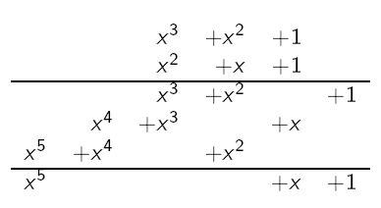
Finite Field Multiplication
Consider for example the field GF(2⁴) with irreducible polynomial x⁴ + x + 1
x⁵ + x + 1 is not in the field GF(2⁴)
So, modular reduction
(x⁵ + x + 1)mod(x⁴ + x + 1) = x² + 1

Slide 15
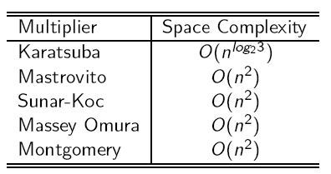
Multiplication Algorithms
The choice of multiplier is determined by the application.
Montgomery for example is suited for low resource environments.
If designed properly, the Karatsuba multiplier is the fastest.

Slide 16
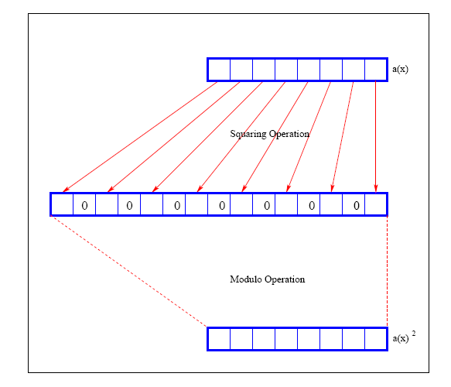
Squaring

Slide 17
Finite Field Multiplication
There are several forms of : Karatsuba multiplier. We consider the combinational type which requires just a single clock cycle.
Two common types of combinational Karatsuba implementations.
Simple Karatsuba Multiplier.
General Karatsuba Multiplier.

Slide 18
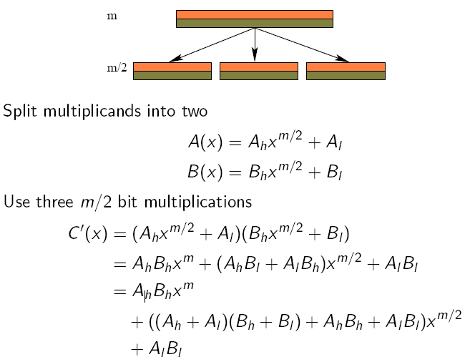
Simple Karatsuba Multiplier

Slide 19
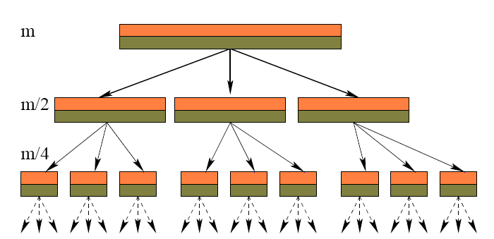
Recursive Simple Karatsuba Multiplier

Slide 20
General Karatsuba Multiplier
Instead of splitting into two, splits into more than two.
For example, an m bit multiplier is split into m different multiplications.
A. Weimerskirch, Generalizations of the Karatsuba Algorithm for Efficient Implementations, Cryptology ePrint Archive, 2006

Slide 21
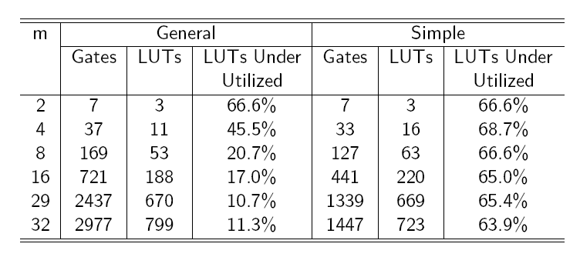
Comparing the General and Simple
Hybrid Karatsuba Multiplier
For all recursions less than 29 use the General Karatsuba Multiplier or school book.
For all recursions greater than 29 use the Simple Karatsuba multiplier
C. Rebeiro, Power Attack Resistant Efficient FPGA Architecture for Karatsuba Multiplier , VLSID 2008

Slide 22
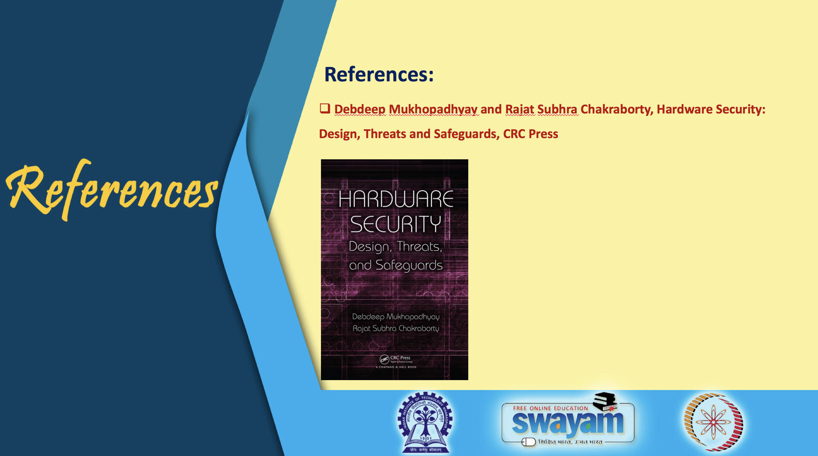

Slide 23
Conclusion:
Finite Field Theory is central to cryptographic algorithms.
Understanding Finite Fields is crucial to develop efficient architectures for cryptographic algorithms.
Binary Finite Fields offer efficient designs.

Slide 24


